Slide 1
Section 11.5 Alternating Series
Lecture 1
The Alternating Series Test

Slide 2

Section Homework Submission to Canvas
Preview of section​
Skim section, write short paragraph summary, list all important definitions / theorems / formulas.​
Notes on video lectures​
Include all details, worked examples, your own thoughts​
Worked examples from text​
Solutions to exercises​
Final reflection of section​
List of key takeaways to remember​

Slide 3
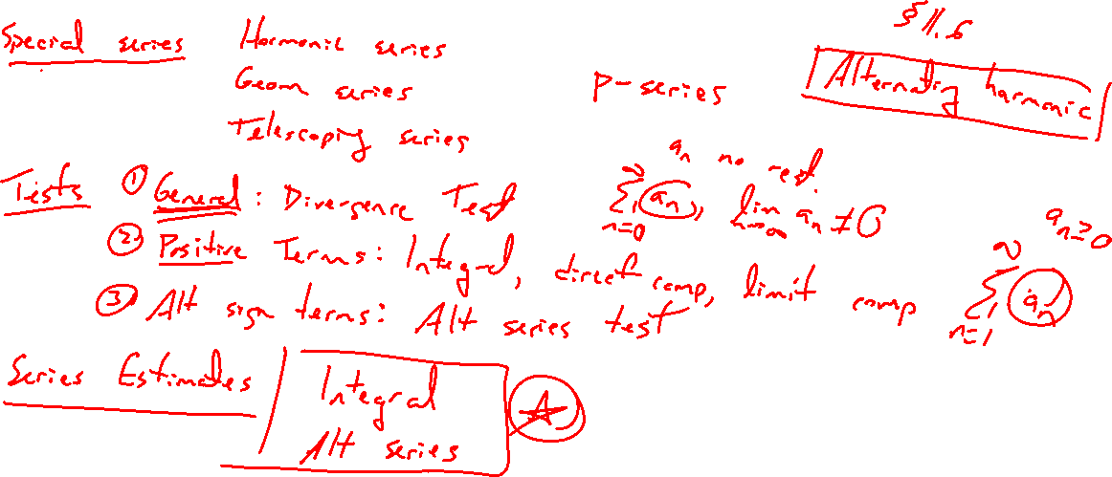
Summary of Results So Far
Notes:
Special series: geom, teles, harmonic, p
Tests for series with pos terms: div, integral direct comparison / limit comparison
Test for series with alternating sign: alt ser test
Estimates: integral, alt ser test

Slide 4
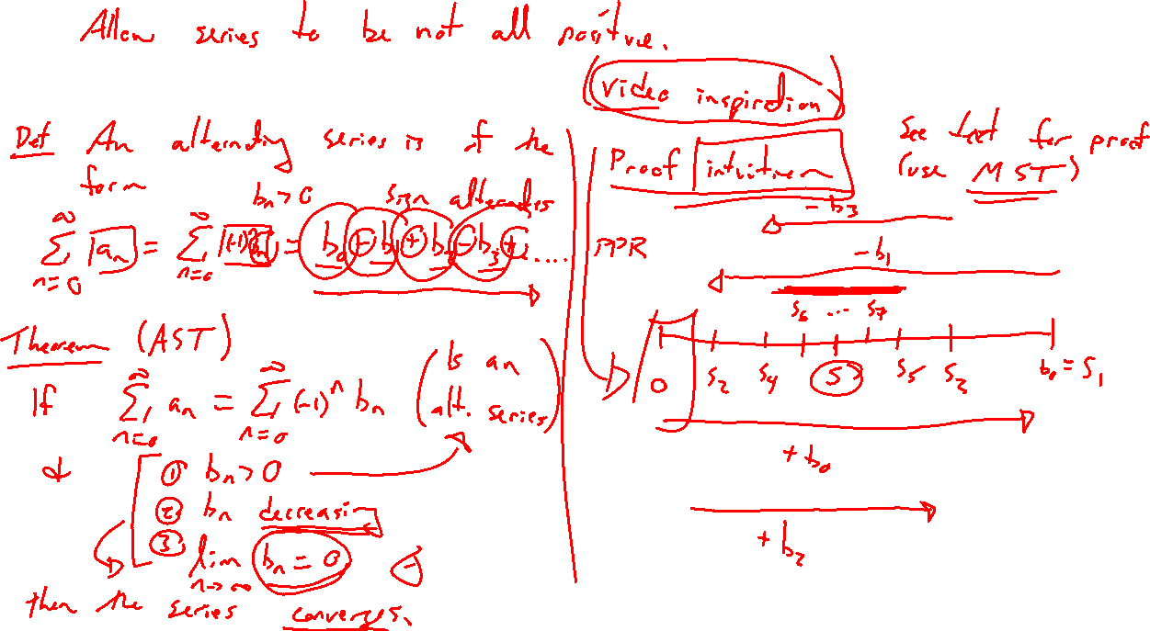
Alternating Series Test
Notes:
Parking ham video
Def: Alt series as sum a_n = sum (-1)^n b_n, b_n > 0
Theorem: Need alternating with b_n decresing and lim b_n = 0
Proof idea: Parallel parking starting at zero
Careful proof in text involves monoton seq theorm

Slide 5
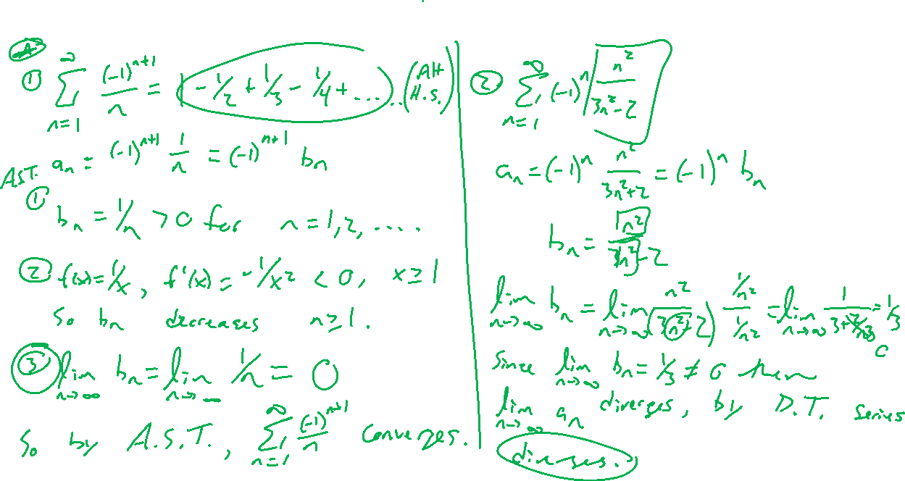
Examples
Notes:
1) Alternating harmonic series converges. Show b_n = 1/n decreases two ways.
2) b_n = n^2/(n^2+n+1), divergence test.

